Slide 1
Movies Recommendation system
Submitted by :
Aditya Rana
Astha Jain
Divya Nageshwar

Slide 2
Outline
1) Introduction
2) Recomendation
3) Recommender
4) Implementation
5) Data Base
6) Architecture
7) Features

Slide 3
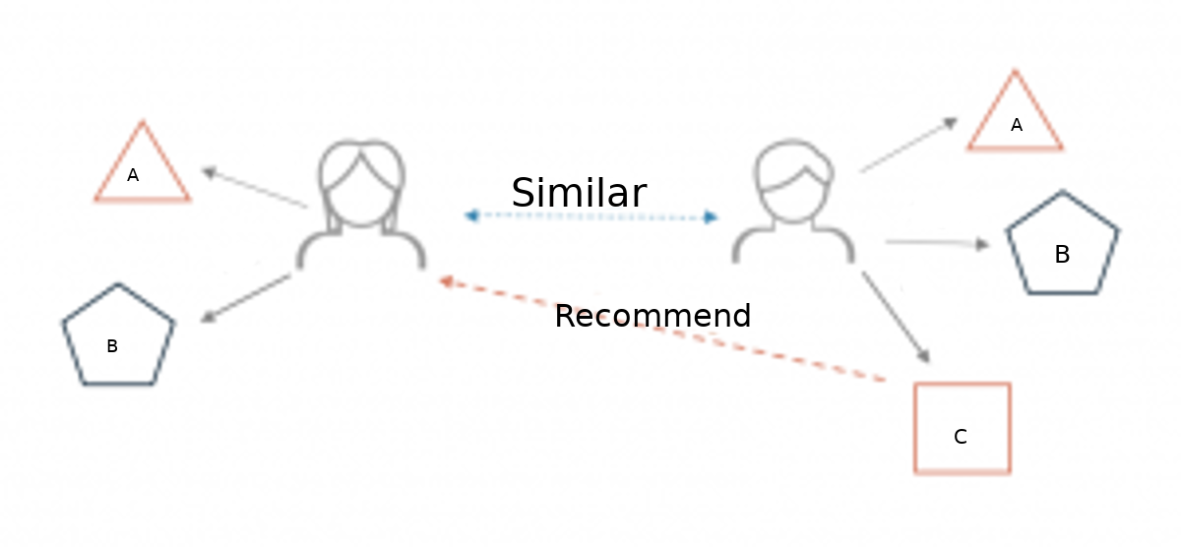
Recommendation
A Recommendation system is a simple algorithm whose aim to provide the most relevent information to a user by discovring patterns in a dataset.
very simple illustration of how recommender systems work in the context of an e-commerce site.

Slide 4
Type of recommendation system:-
Contant based
Collaborative filtering
Hybrid Recommendation Systems
Type of collaborative filtering
User based collaborative filtering
Item based collaborative filtering

Slide 5
Contant based
These filtering methods are based on the description of an item and a profile of the user’s preferred choices. In a content-based recommendation system, keywords are used to describe the items; besides, a user profile is built to state the type of item this user likes. In other words, the algorithms try to recommend products which are similar to the ones that a user has liked in the past. The idea of content-based filtering is that if you like an item you will also like a ‘similar’ item.

Slide 6
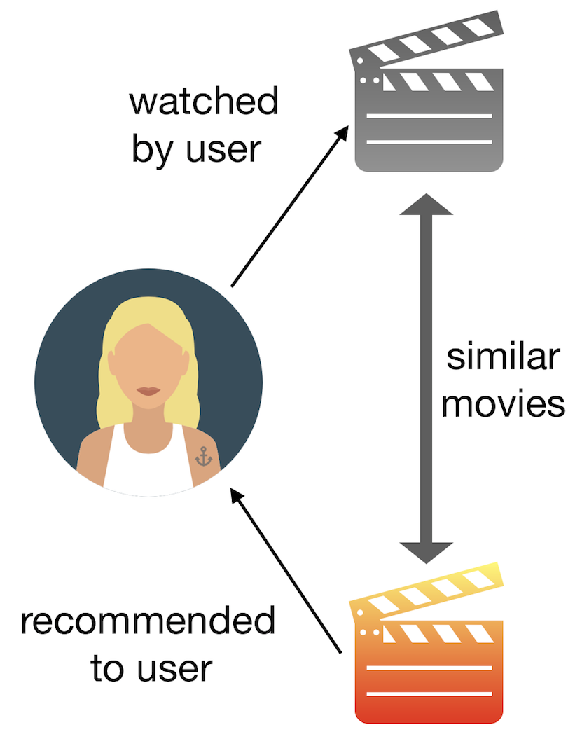
Example of Contant based

Slide 7
Collaborative Filtring
The recommendation system recommends movies which are rated highly by the similar users.
f(movies, user) → {movieks}
Collaborative Filtering system maintains a database of many users’ ratings of a variety of items.
Makes use of the user data, ignoring content / item data.
Almost all existing commercial recommenders use this approach (e.g. Amazon, Facebook, LinkedIn).

Slide 8
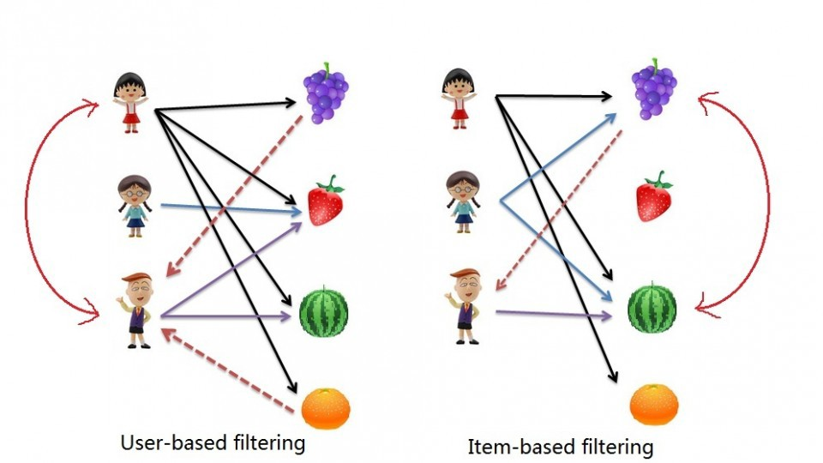
Example of Coleborative filtring

Slide 9
Hybrid Recommendation systems:
combining collaborative and content-based recommendation can be more effective. Hybrid approaches can be implemented by making content-based and collaborative-based predictions separately and then combining them. Further, by adding content-based capabilities to a collaborative-based approach and vice versa; or by unifying the approaches into one model.

Slide 10
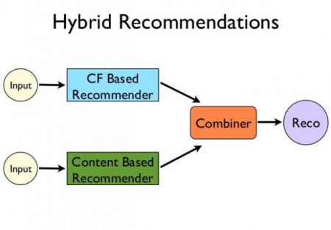
Example of Hybrid Recomendation

Slide 11
Requirements
Data set
Movielens
20million Rating
27000 Movies
1,38,000 Users
Mahount
Given rating matrix produces N recommendation per user
Uses ALS algorithm
Recommendations are used by web server
Recomputed when new ratings are provided by user

Slide 12
Implementation
Platfroms
Watson studio
Additionl software
Jupitar notebook
Mahunt
mysql
Languages
Python
java

Slide 13
Data Base
User Table
Login & customer information
Movie Table
Movie name, year, IMDB link, and poster
Most information already provided in the dataset
Posters scraped from IMDB a priori for client applications
MySQL implementation

Slide 14
Architecture
Client app
Key components:
Recommender
Database
Web server
Client application
Web server
Recommender
Database

Slide 15
Features
Login system
Ability to create new accounts on the fly
View personalized recommendations
Search database for movies
Enter new ratings

Slide 16
THANK YOU

